Slide 1
Tata Motors – Corporate Governance Score Evaluation
Manual Testing Report
May 2025
Prepared by: [Monil Shah/ Supriya Jadhav]

Slide 2
Objective
Validate system-generated answers against actual disclosures in company documents
To assess governance score outputs are acceptable, explainable, and grounded in evidence
Focus on randomly selected test questions from each governance principal category and present the evidence.

Slide 3
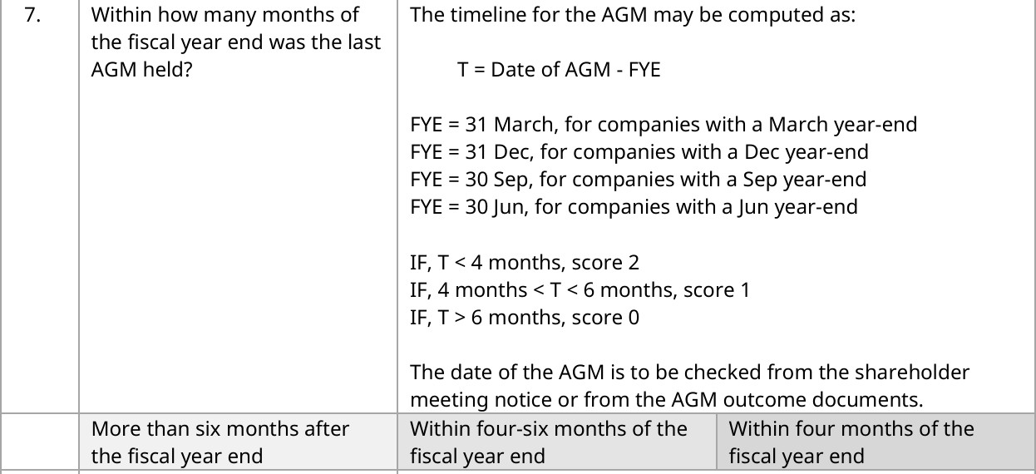
Category I – Shareholder Rights
Question #7: Question, guidance & rubric

Slide 4
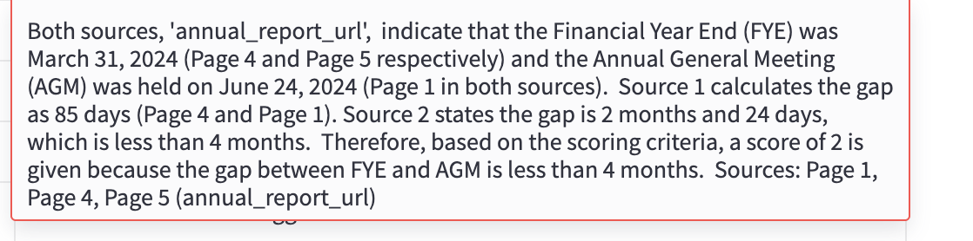
Category I – Shareholder Rights
Question #7: System output

Slide 5
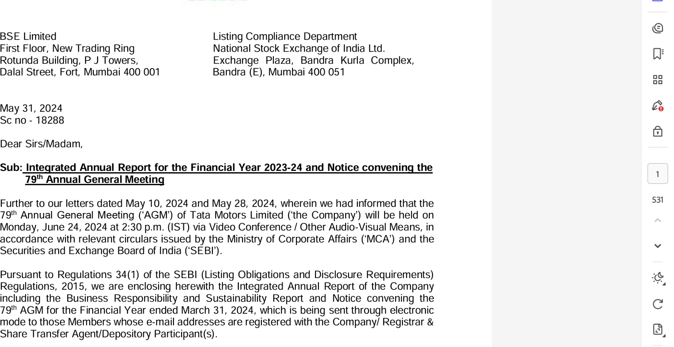
Category I – Shareholder Rights
Question #7: Evaluation (1/2)

Slide 6
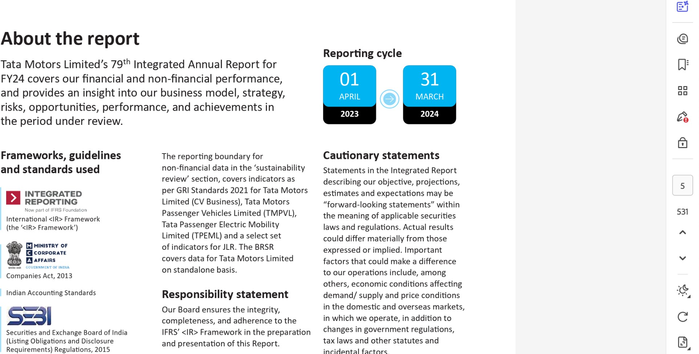
Category I – Shareholder Rights
Question #7: Evaluation (2/2)

Slide 7
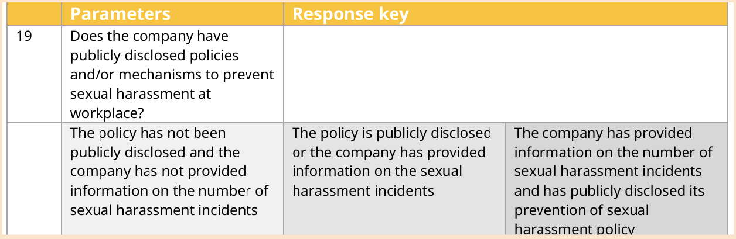
Category II – Stakeholder Role
Question #19: Question, guidance & rubric

Slide 8
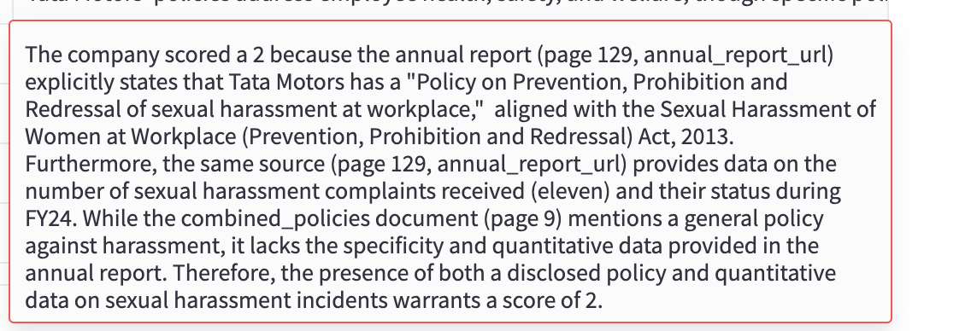
Category II – Stakeholder Role
Question #19: System output

Slide 9
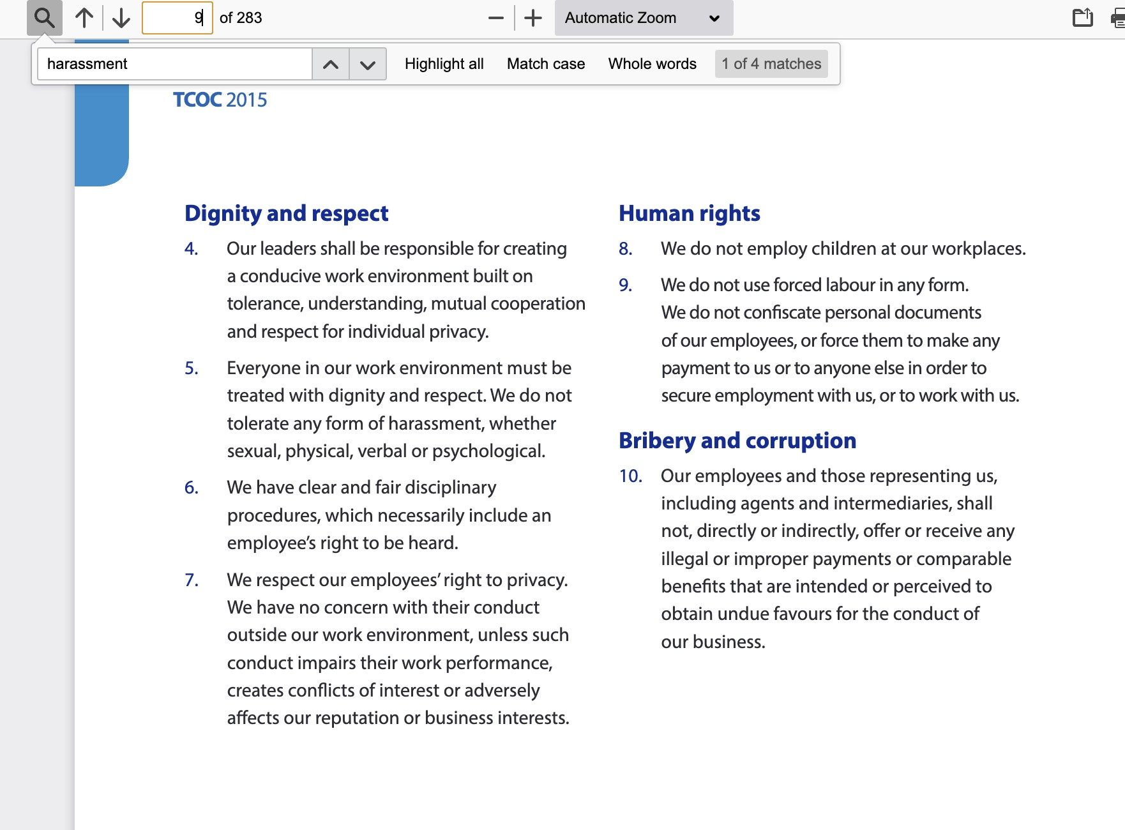
Category II – Stakeholder Role
Question #19: Evaluation (1/2)

Slide 10
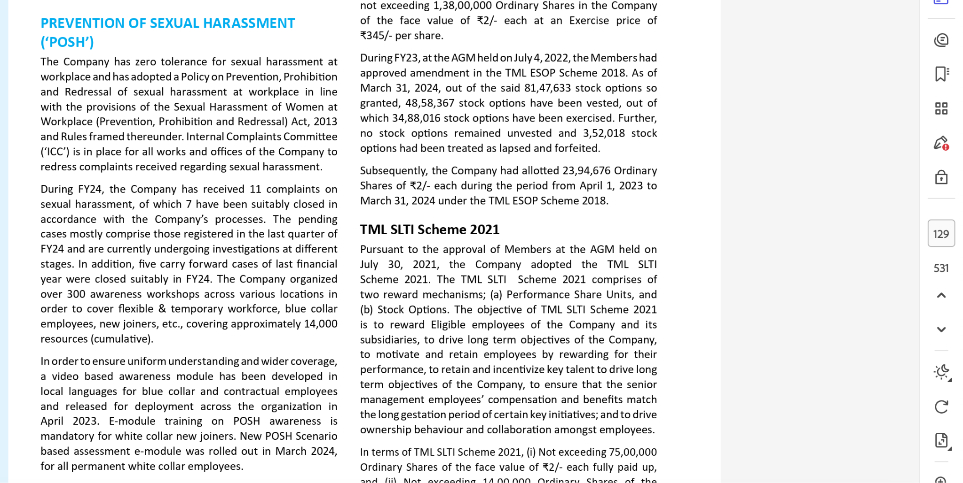
Category II – Stakeholder Role
Question #19: Evaluation (2/2)

Slide 11
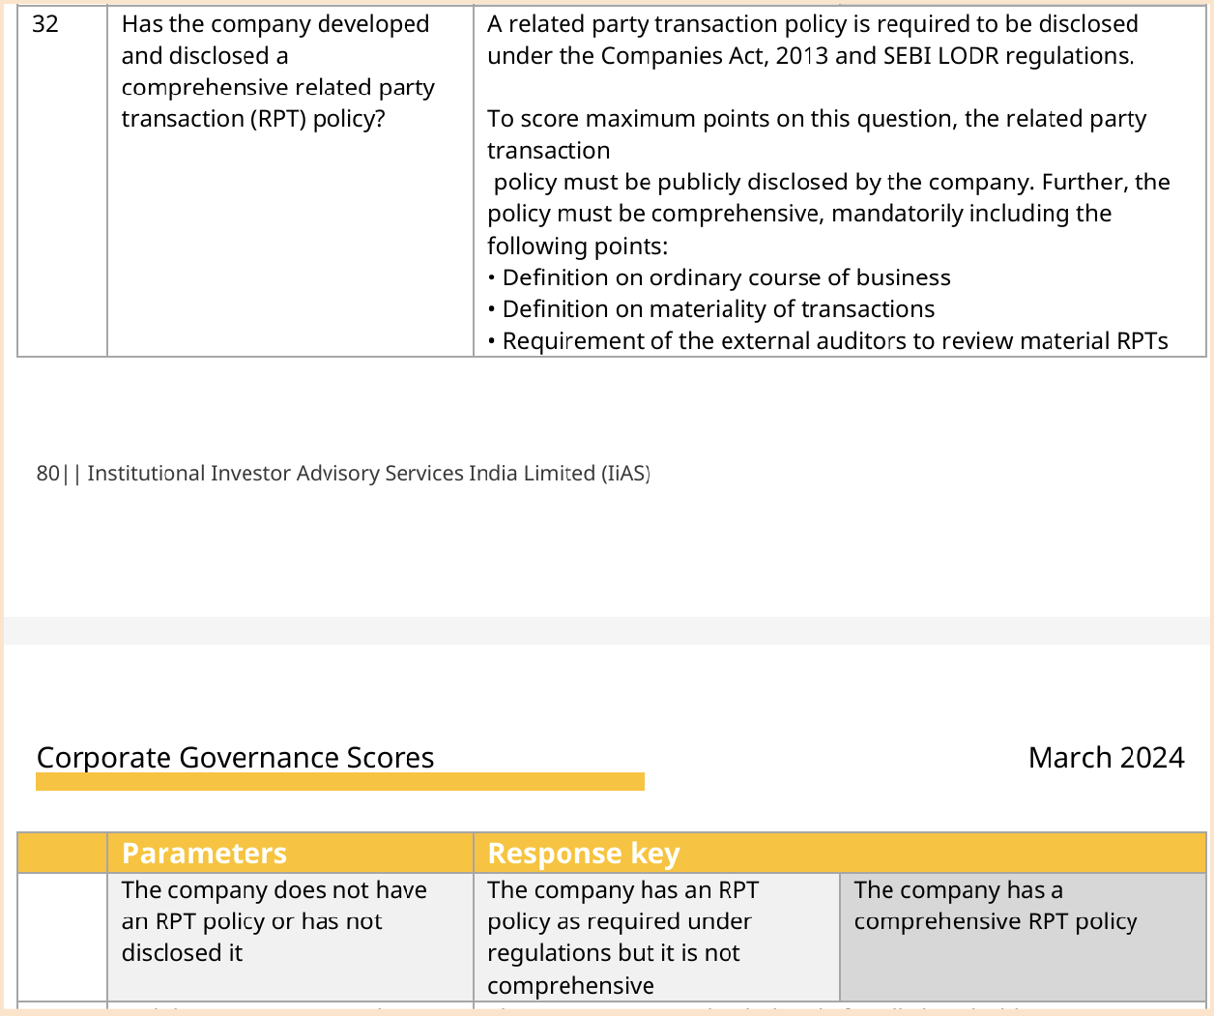
Category III – Transparency and Disclosure
Question #32: Question, guidance & rubric

Slide 12
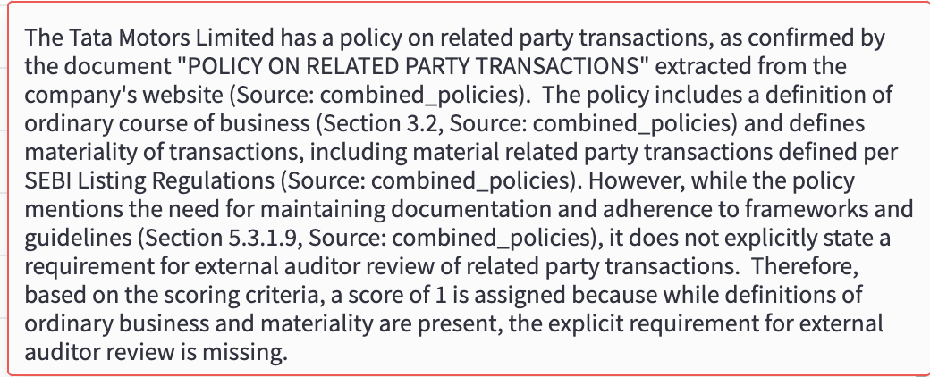
Category III – Transparency and Disclosure
Question #32: System output

Slide 13
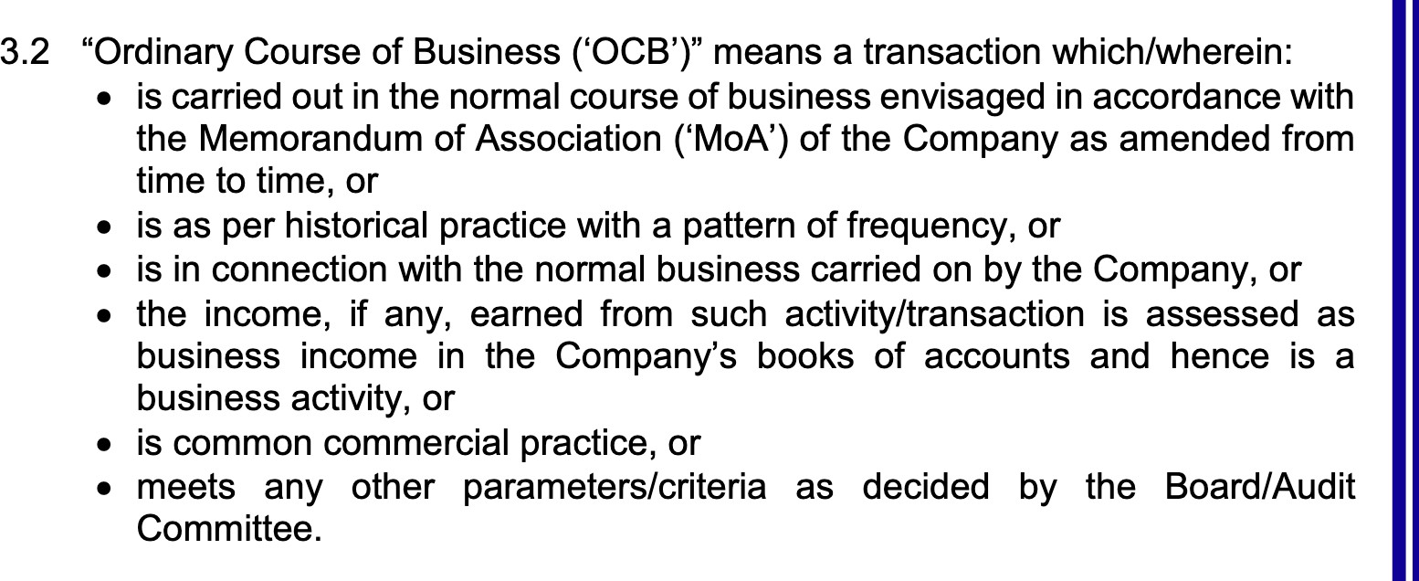
Category III – Transparency and Disclosure
Question #32: Evaluation (1/3)

Slide 14
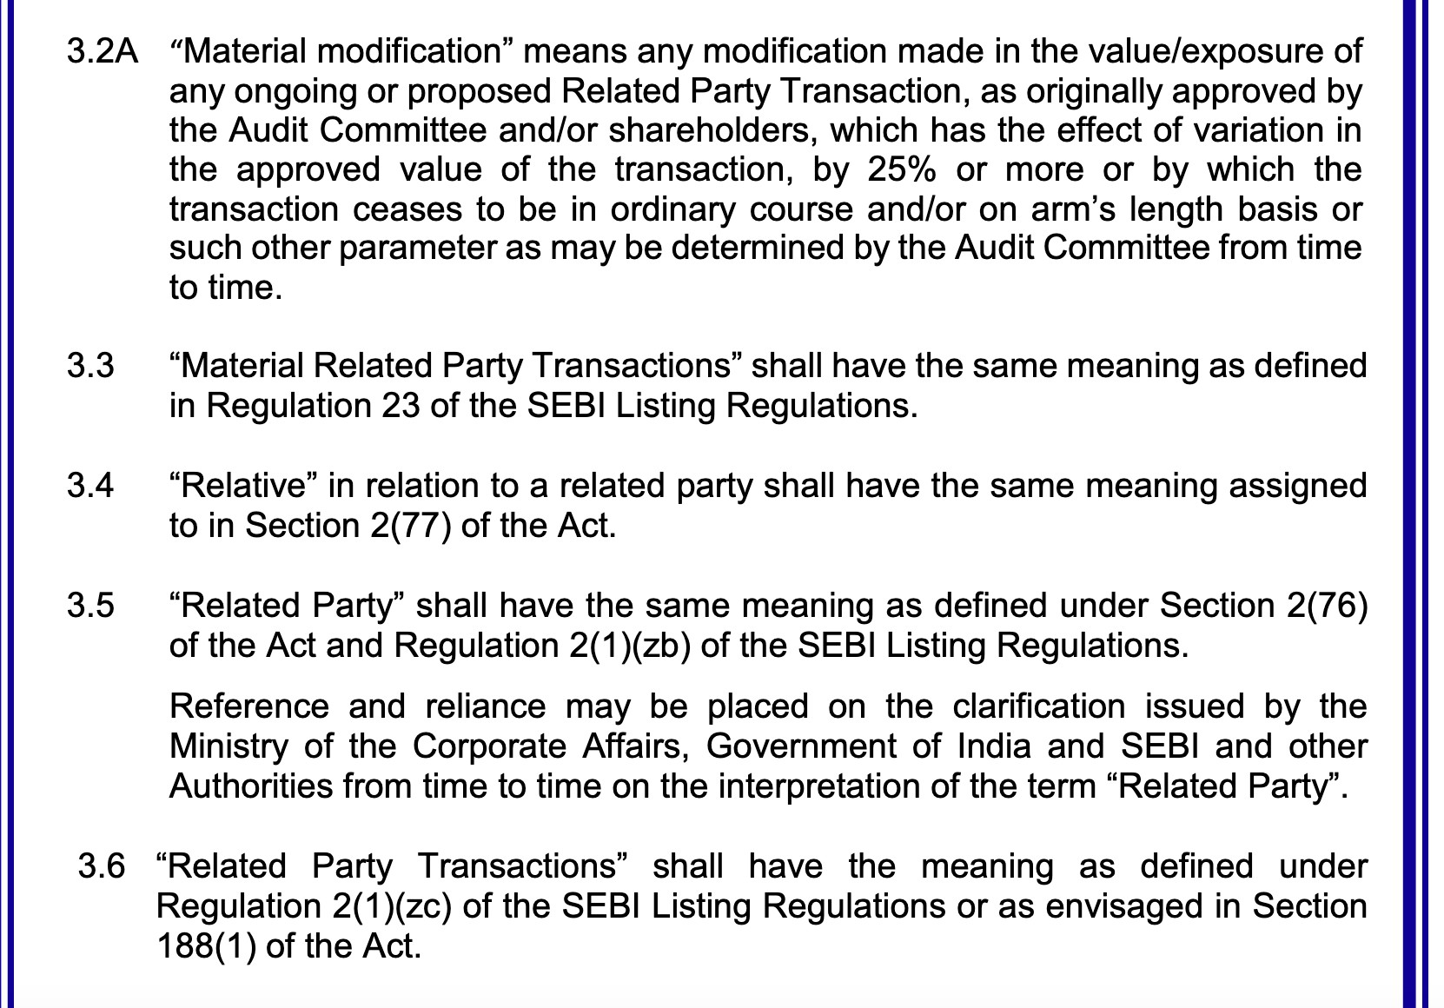
Category III – Transparency and Disclosure
Question #32: Evaluation (2/3)

Slide 15
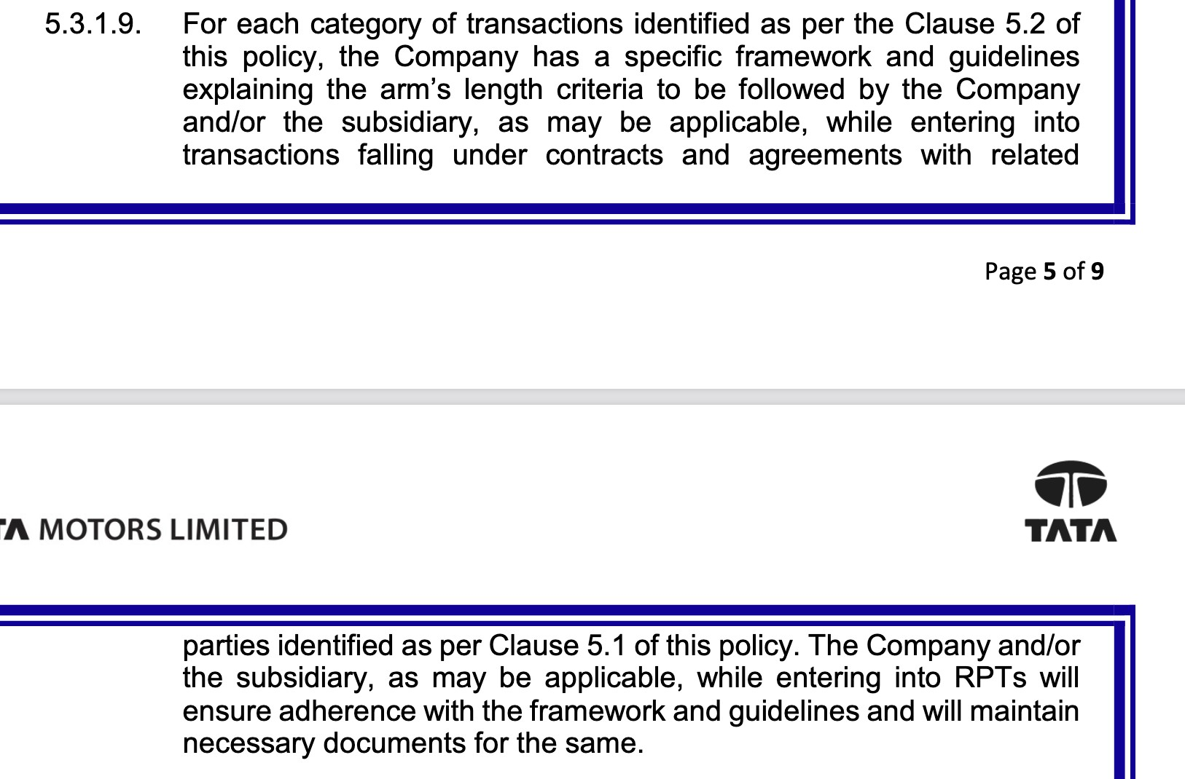
Category III – Transparency and Disclosure
Question #32: Evaluation (3/3)

Slide 16
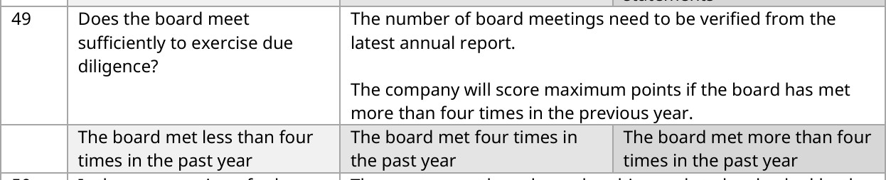
Category IV – Responsibilities of the Board
Question #49: Question, guidance & rubric

Slide 17
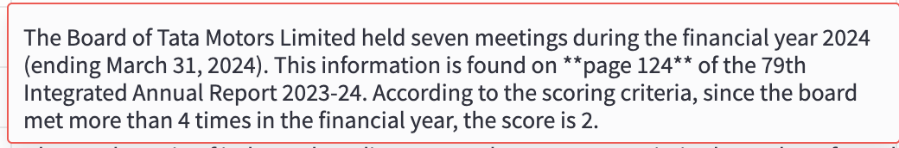
Category IV – Responsibilities of the Board
Question #49: System output

Slide 18
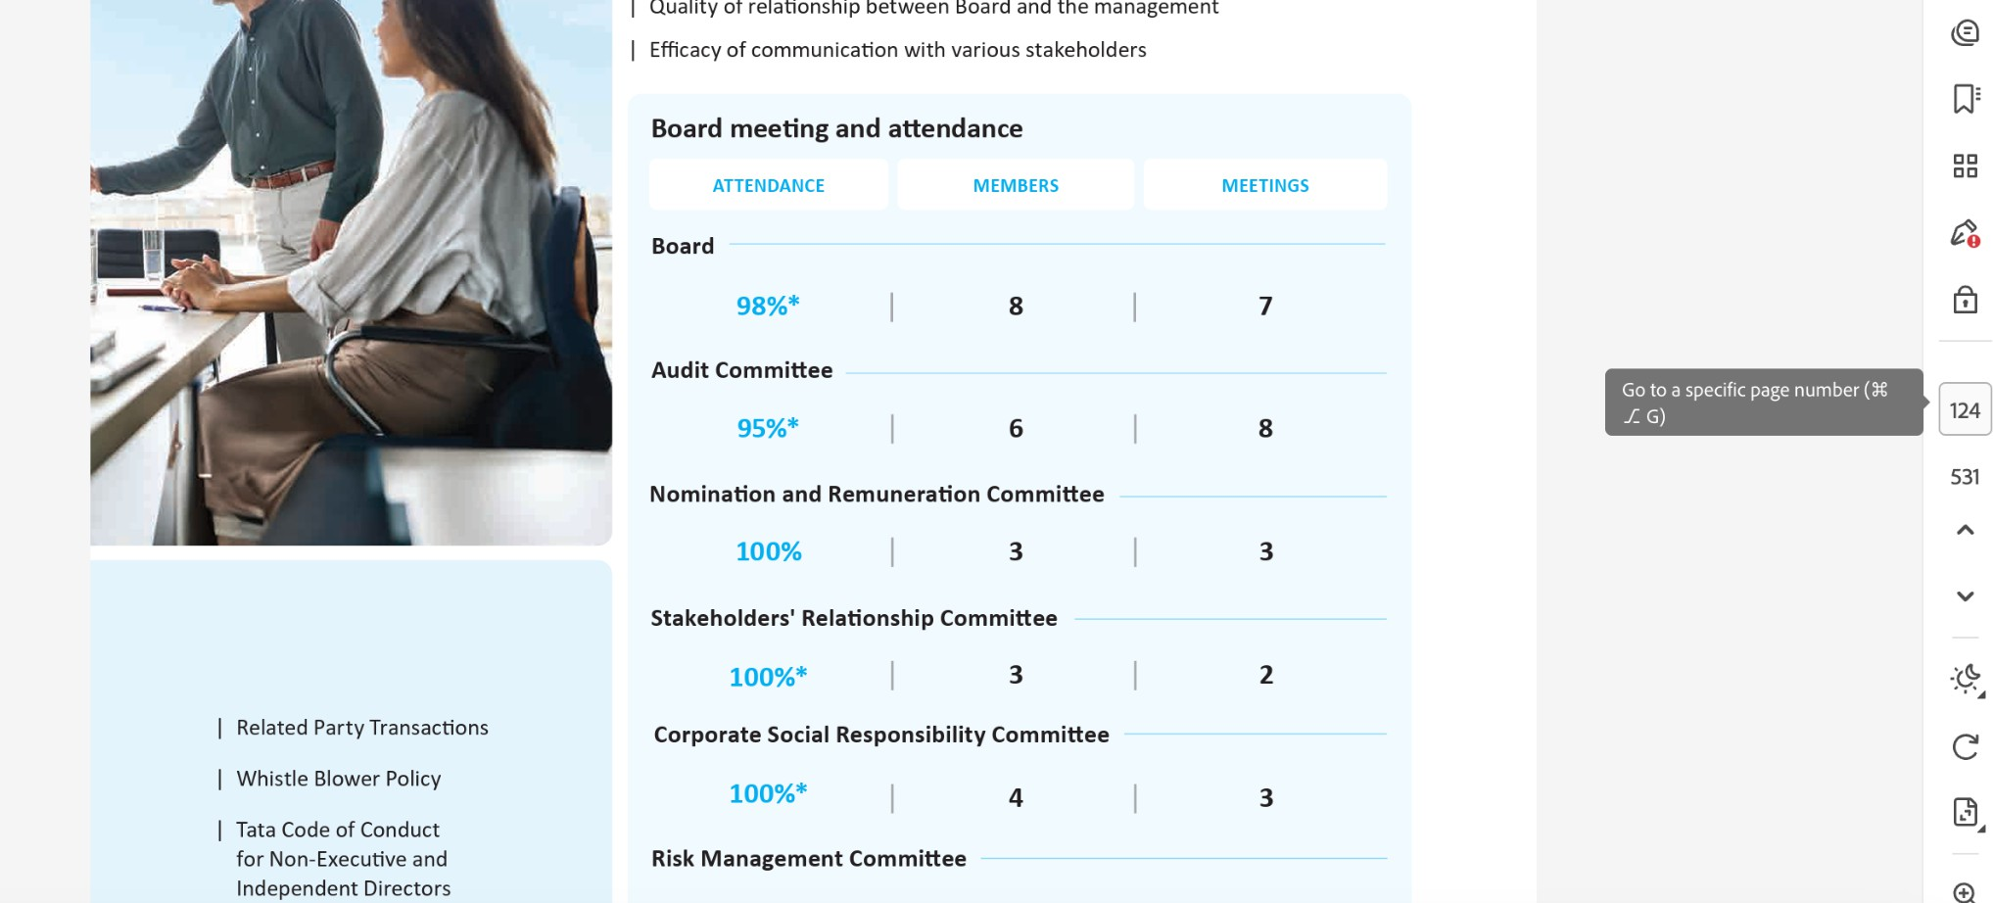
Category IV – Responsibilities of the Board
Question #49: Evaluation

Slide 19
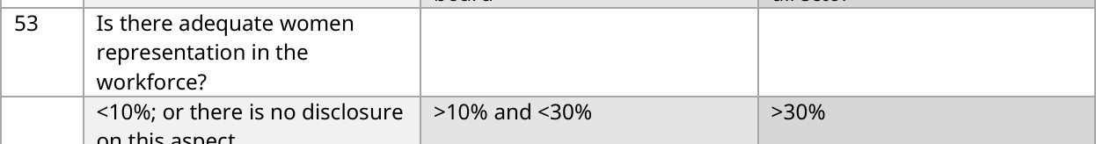
Category IV – Responsibilities of the Board
Question #53: Question, guidance & rubric

Slide 20
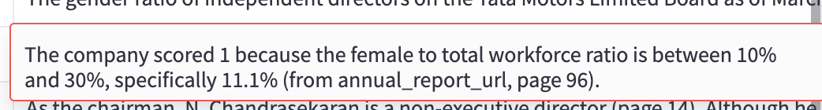
Category IV – Responsibilities of the Board
Question #53: System output

Slide 21

Category IV – Responsibilities of the Board
Question #49: Evaluation

